Slide 1






PAISA
BARHAO

Slide 2
ABOUT US
Greetings! Welcome to our presentation.We are Khadija, Haniya, and Shahbaz a dynamic trio passionate about leveraging technology to empower individuals in the realm of finance. As software engineers with a keen interest in artificial intelligence (AI) and software engineering, we've embarked on a mission to revolutionize the investment landscape in Pakistan.As software engineers specializing in AI and software engineering, Khadija, Haniya and Shahbaz bring a wealth of technical expertise to our project. Khadija, with her proficiency in AI and software engineering, is the driving force behind our innovative solutions. Haniya, an integral member of our team, specializes in AI and data engineering. Her expertise in these domains adds a critical dimension to our project, enabling us to harness the power of data-driven insights and AI algorithms to deliver a cutting-edge solution.Shahbaz, our data scientist, infuses our team with a fervent passion for AI in finance. He pioneers AI-powered solutions, unlocking invaluable financial insights and pushing the boundaries of innovation within the FinTech space., we form a formidable team poised to revolutionize investment in Pakistan

Slide 3



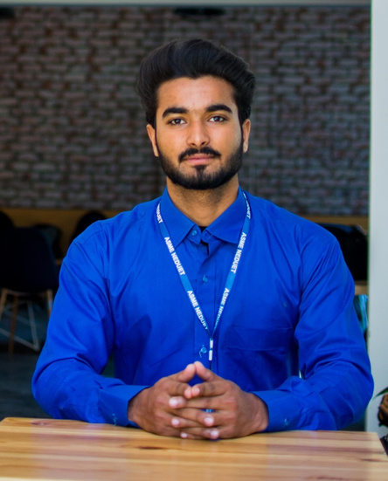
MEET OUR TEAM
Khadija
Haniya Maqsood
Shahbaz Muneer
Software Engineer
The creative force behind frontend development. Armed with React.js expertise, seamlessly integrates design with functionality to deliver an exceptional user experience.
Data Engineer
Behind the scenes, she works her magic on the backend, architecting robust APIs that power our platform's functionality. Her mastery of data engineering ensures that our project operates smoothly and efficiently
Data Scientist
Brings invaluable finance knowledge to our team, guiding our project with insights that ensure financial efficacy and sustainability, his meticulous documentation work ensures that every aspect of our project is well-documented.

Slide 4

ABOUT TECHNOLOGY
Our engineering approach behind SmartInvest.AI prioritizes efficient data acquisition, effective data representation using vector embeddings, and leveraging the power of large language models (LLMs) for intelligent question answering and investment recommendations. We utilize a Python library for retrieving up-to-date stock data and format it into a CSV file for ingestion. The LangChain CSVLoader efficiently imports this data into our FAISS vector database, enabling us to store vector embeddings of the stock data for efficient retrieval. Our LangChain GooglePalm LLM model plays a crucial role in understanding user queries and generating relevant responses, facilitated by the RetrievalQA class, which retrieves relevant stock data from the FAISS vector DB based on the user's question. Additionally, an API integration fetches the latest data from the Pakistan Stock Exchange library to ensure our system remains updated with the most recent market information.
Artificial Intelligence

Slide 5


ABOUT OUR PROJECT
Generative AI
Our project, SmartInvest.AI, stands at the intersection of finance and technology, harnessing the power of generative artificial intelligence (AI) to revolutionize investment accessibility. With a focus on democratizing financial resources, SmartInvest.AI offers accessible insights into various investment options tailored to the Pakistani market. Leveraging generative AI, our platform empowers users with personalized recommendations and real-time updates, fostering financial literacy and inclusion. Through the integration of cutting-edge technology, we strive to break down language barriers and simplify the investment process for individuals of all backgrounds.

Slide 6







OUR VISION AND MISSION
Empower Ethical Investing
Break Down
Barriers
Promote Financial Inclusion
empower individuals to make informed and ethical investment decisions in the stock market. By leveraging generative AI technology, we aim to provide accessible and halal investment guidance tailored to the unique needs and preferences of our users
Our mission is to ensure that all users, regardless of their background or level of experience, can access relevant information and receive personalized guidance in a user-friendly manner.
Through our platform, we strive to promote financial inclusion by catering to a diverse audience interested in ethical and halal investments.

Slide 7


PROJECT SCOPE

Slide 8






ACCESSIBLE INSIGHTS
SmartInvest.AI offers accessible insights into various investment options, including stocks, commodities, and mutual funds, specifically tailored to the Pakistani market.
VALUABLE INFORMATION
Users can access valuable information and comparisons within the app, empowering them to make informed investment decisions. This feature promotes financial literacy and inclusion among users
MULTILINGUAL SUPPORT
The platform provides multilingual support in Urdu and Roman Urdu for both information and app functionality, ensuring accessibility for users from diverse linguistic backgrounds.
USER-FRIENDLY INTERFACE
SmartInvest.AI boasts a user-friendly interface designed to simplify the investment process for users of all experience levels. Whether you're a novice investor or a seasoned trader, navigating the platform is intuitive and straightforward.

Slide 9

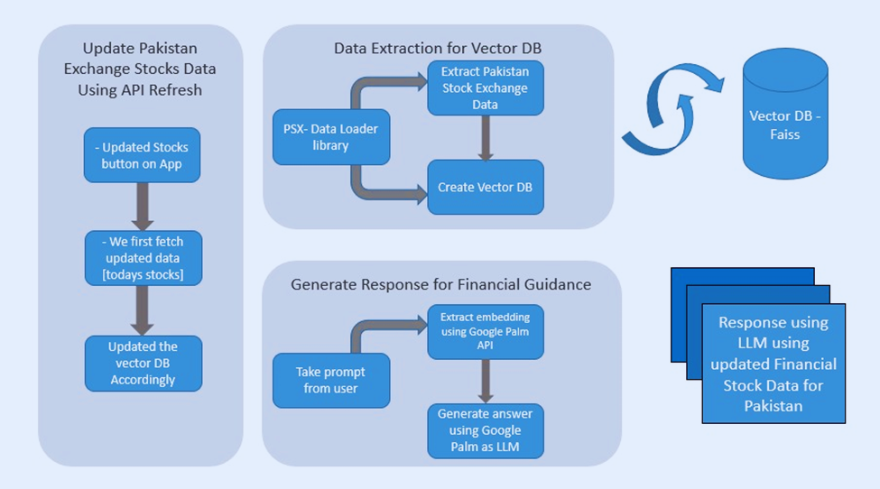

TECHNICAL ARCHITECTURE

Slide 10




RESULTS AND ACHIEVEMENTS
SmartInvest.AI has successfully addressed the longstanding challenge of financial exclusion in Pakistan by providing accessible investment insights tailored to the needs of diverse user groups. Through multilingual support, a user-friendly interface, and personalized AI-powered guidance, SmartInvest.AI has empowered Urdu-speaking majority, uneducated individuals, street vendors, and others with limited financial literacy to participate confidently in investment activities
01
The engineering approach behind SmartInvest.AI has not only enabled the delivery of intelligent investment recommendations but has also set new standards for user experience and engagement in the FinTech sector. By leveraging advanced technologies such as Python stock reader, FAISS vector database, and LangChain GooglePalm LLM model, SmartInvest.AI ensures efficient data acquisition, effective data representation, and personalized question answering.
02

Slide 11

THANK YOU!

